Slide 1

FLOYD-WARSHALL
By : - Israa Abdelghany
- Alaa Khaled

Slide 2

PROBLEM DESCRIPTION
The Floyd-Warshall algorithm is used to find the shortest paths between all pairs of vertices in a weighted graph (both directed and undirected). It works for graphs that have positive or negative weights.

Slide 3
FLOYD-WARSHALL
It is a dynamic programming algorithm that efficiently computes the shortest paths for all node pairs.
Works well for small to medium-sized graphs and can handle graphs with negative edge weights .

Slide 4
SOLUTION APPROACH
Create a distance matrix where
Loop through all nodes as intermediate points (k).
Update shortest distances:

Slide 5
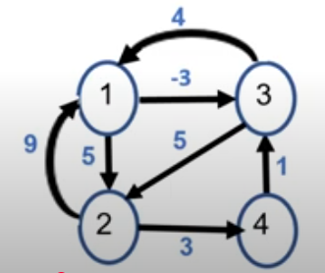
DISCUSSION

Slide 6
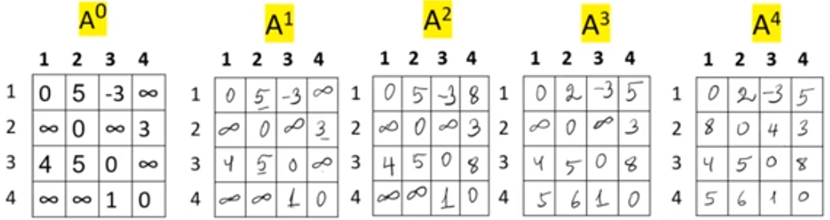
DISCUSSION

Slide 7
Implementation

Slide 8
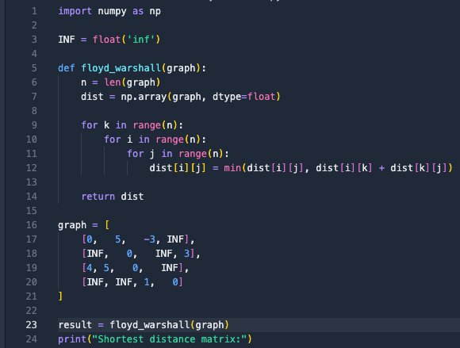

Slide 9
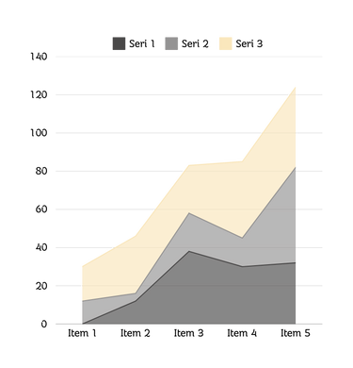
TIME COMPLEXITY
The time complexity of the Floyd-Warshall algorithm is O(n³) because:
• There are three nested loops (for k, for i, for j).
• Each loop runs up to n times, resulting in a total of n × n × n = O(n³) iterations.

Slide 10
APPLICATIONS
Real-world uses: Computer networks, GPS navigation, social networks.
Comparison with Dijkstra: Works for all pairs at once but is slower for a single-source case.
Limitations: Not efficient for very large graphs.

Slide 11
THANK YOU

